Slide 1
How to Fix the Market for Event Tickets
Eric Budish
Professor of Economics
University of Chicago, Booth School of Business
First scalped ticket: Sept 17, 1986 (Mets clinch)
FTC Workshop “That’s the Ticket” on
Consumer Protection Issues in the Ticket Market
Notes:
Thanks to the Federal Trade Commission for hosting this event and for the honor of speaking.
This is an important market, that’s close to my heart both as an economist and as a customer.
As a customer, I’ve been using this market since I was a little kid, and thinking back, my first secondary market ticket was in 1986, the Mets division clincher. This was back in the day when fans stormed the field afterwards and ripped up the grass.
I was a happy-as-could-be 8 year old, in the left field loge with my dad, and we wouldn’t have been there without the secondary market.
But as an economist, it’s clear that the ticket market is broken in significant ways, especially in the last 15-20 years or so as both the primary market and the secondary market have moved to the internet.
My job is not to ask the black or white question “should there or shouldn’t there be a secondary market” for tickets, but to ask the more nuanced, and practical, question “what market rules would enable this market to work better.”
You may be surprised to hear a University of Chicago economist talking about market rules and regulations, but that’s a big misunderstanding of Chicago economics that I’ll come back to in the conclusion.

Slide 2
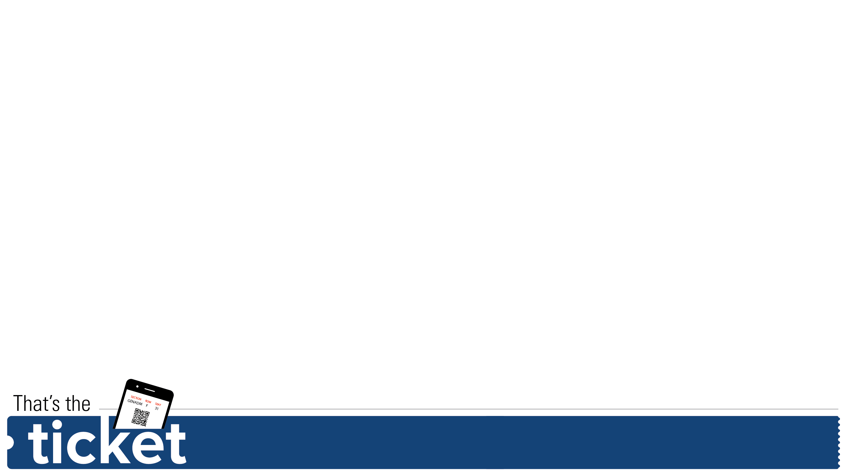
Charles Dickens, Nov 1867
Boston, November 1867
“... But the crowd out in the cold was a most patient, orderly and gentlemanly crowd, and seemed determined to be jolly and good-natured under any circumstances.”
“Jokes were cracked, some very good and some very poor; quotations from Dickens were made, some apt and others forced…”
“Everything in the sale of tickets within the store seemed to be conducted with entire fairness. The limit was set at forty-eight tickets to one person—twelve course tickets—so as to prevent, as much as possible, ticket speculating.”
“But this was not entirely avoided. Speculators were on the streets and in the hotels selling tickets readily for $10 and $15 each for the opening night, and a few as high as $20 each. Tickets for the remaining three nights were also sold by speculators at high prices. At about 7:30 o’clock last evening every good seat and nearly every poor seat in the hall were sold; indeed, the only seats that could be bought were those on benches in very unpleasant places.”
Notes:
I want to start with an anecdote from the 1860s, over 150 years ago.
Charles Dickens was doing a tour of the U.S., and it was a hot ticket.
Here’s press coverage from the first stop in his tour, Boston.
The article is called “Mr. Dickens in Boston – The Excess Demand for Tickets”, with “excess” spelled in an old-timey way, and I want to read you a few excerpts.
The crowd in line for tickets was described as “patient, orderly”, “jolly and good-natured.”
They were reading each other Dickens quotes to stay entertained, “some apt and others forced.”
“Everything in the sale of tickets … seemed to be conducted with entire fairness” and in particular there were ticket limits in place, to “prevent, as much as possible, ticket speculating.”
“But, this was not entirely avoided” and tickets were resold for as much as $20, which is about $400 in today’s money, up from a face value of $2.

Slide 3
Charles Dickens, Dec 1867
Three weeks later, in New York City …
“... the widespread notoriety of the sale … had the effect of gathering an immense concourse of persons, long before the hour appointed. At 8 o’clock, Tuesday evening, a little newsboy took up his station next the main door … Gradually this number was augmented until at day-break over 150 persons had gathered”
“A large proportion of those standing near the head of the line were ticket speculators, but scattered through the single file were many laboring men and several little boys, who only came to be bought off. The little fellow who led the force was very fortunate in selling his place to a Southern gentleman, it is said, for $30 in gold. There were many such instances—indeed it was not uncommon for anxious individuals to give from $10 to $30 for the privilege of supplanting another.”
“A detachment of Police officers … was present to preserve order.”
“…the unsuccessful ones who brought up the rear, retired with expressions of disgust more forcible than elegant.”
Notes:
Here’s an article from the next month in New York.
This time the article describes a crowd where “a large proportion of those standing near the head of the line were ticket speculators”, and then “little boys” who were planning to sell their place in line.
One boy sold his spot in line for $30 in gold.
Police were on the scene.
Fans who missed out on tickets “retired with expressions of disgust.”
So it took about one month for the market to go from patient and orderly, with fans reading each other Dickens quotes, to a market taken over by ticket speculators, with police on the scene and children taking bribes.
A New York Times op-ed from the era, described [quote] “gangs of hardened ticket speculators” who “carry on their atrocious trade with perfect shamelessness.”

Slide 4
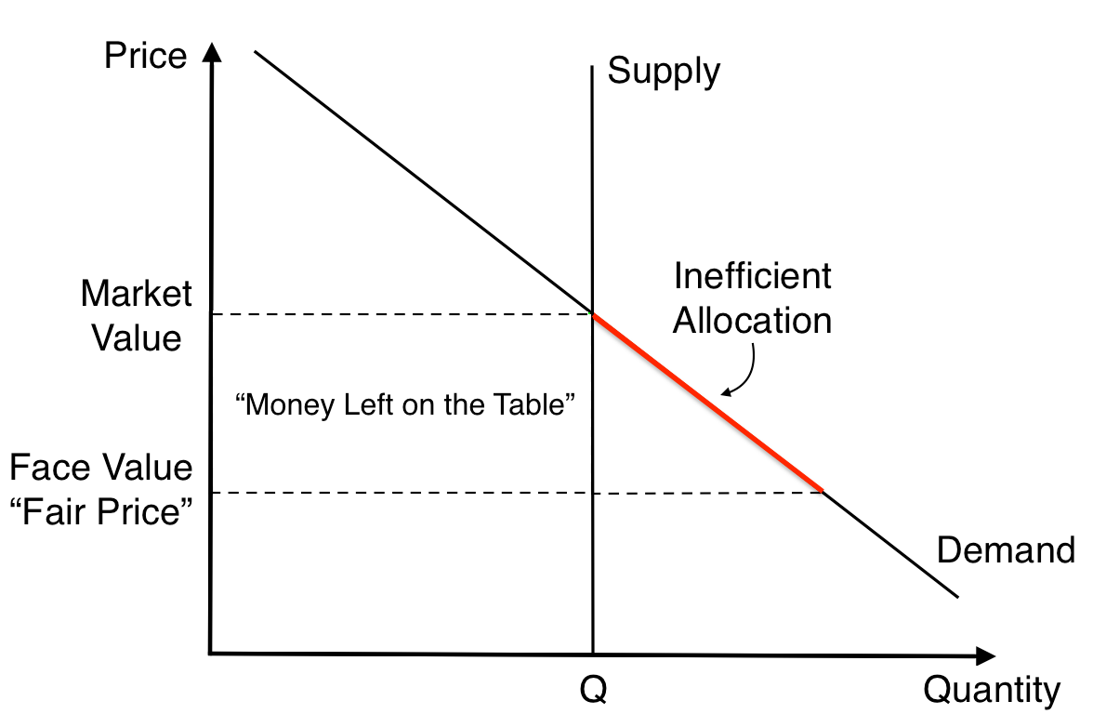
Economics of Underpricing, Without Resale
Issue 1: Inefficient allocation
Issue 2: Seller leaves “money on the table”
Gary Becker, 1991: “along with many others, I have continued to be puzzled by such pricing behavior”
Notes:
This is just to say that underpriced event tickets, and the associated resale market, rent-seeking activity, and controversy, have been around for a LONG time.
But I want to start with the economics of underpricing WITHOUT resale. Here’s the basic textbook supply-and-demand diagram.
Assume there is a fixed supply, Q, let’s think of this as tickets that are all the same quality.
The demand curve depicts the valuations of consumers for these tickets, from very high to much lower.
There’s a market-clearing price, of course, which is where Supply and Demand cross.
And then the diagram also depicts the below-market price actually used, denoted as the “Face Value” of the ticket.
There are two traditional economic problems with underpricing.
One issue with setting too-low of a price is that the allocation will be INEFFICIENT
a. Some customers with low valuations, highlighted in the red part of the demand curve, will get allocated tickets that could have more efficiently gone to customers with higher values.
The second issue with setting too-low of a price, the more obvious one, is that the seller is LEAVING MONEY ON THE TABLE
The rectangle area depicts exactly how much money the seller loses, because either way they sell Q tickets, but for less money per ticket. This is marked “Money Left on the Table”
Gary Becker, the famous University of Chicago economist and Nobel Laureate, wrote in a famous article that he has been puzzled by such behavior for decades.

Slide 5
Economics of Underpricing, Without Resale
But many economists, including Becker, found reasonable explanations for underpricing
  Events are a social good
  Public image, want to be perceived as “fair”
  “Best” fans might not be those able to pay the most
  Careers are long (hopefully)
Underpricing as in the long-run interests of the artist/team, not some big economic blunder
Notes:
But in the context of event tickets specifically, many economists, including Becker, have provided plausible explanations for underpricing
Becker’s explanation was that events are a social good
Nobody wants to go to a concert that is half-full with only rich guys
Fans get utility from being at events that have excess demand
Another common explanation is that artists and teams might have a PR reason for setting a price perceived as “fair”, especially for fans who are die-hard fans but don’t have a lot of money
This is an argument that by underpricing, you might make less money on the tickets in the short-run, but make more money in the long run by preserving your reputation, good-will with fans, and so forth
All of these economic explanations are stories for why underpricing can be in the long-run interests of the artist or team, not some big economic blunder. Not profit-maximizing for this particular show, but, if you will, “long run greedy”

Slide 6
Resale Technology, Then and Now
Dickens Era
  Primary market: lines, queues
  Secondary market: resellers mainly outside the venue, at hotels, etc.
As recently as 1990s: similar to Dickens Era
  Spitzer AG report. “Diggers”, “Scalpers”, “Ice”
Economics of Pre-Internet Ticket Resale
  Localized
  Few economies of scale
    One person = one spot in line
    One person = one tout outside the venue
    (Exception: corrupt box offices.)
  A bit shady …
Notes:
The big thing that’s changed since the Dickens era, and even the era in which Gary Becker was writing, is the nature of the technology used for the resale market
In the Dickens era
The technology in the primary market was lines or queues, and
The technology in the second market was resellers outside the venue, or at hotels, and so forth
As recently as the 1990s, the technology was pretty similar
The New York Attorney General’s office, back when it was run by Eliot Spitzer, put out a report called “Why Can’t I get Tickets” that has great color on the resale market just before the rise of the internet
There are two key economic points I want to emphasize about pre-internet ticket resale
First, it was localized
Second, there were few economies of scale
One person could get one spot in line
One person could be one reseller outside the venue
The exception, where there were some economies of scale, was what I think of as Corrupt Box Offices. There’s this great fact, buried in footnote 34 of the AG report, that for Phantom of the Opera, the “ice”, or bribes, paid to the box office to divert tickets to resellers, exceeded the show’s actual profits.
But for the most part, this was a market that was local, low-scale, and, to use the technical term, a bit “shady”.

Slide 7
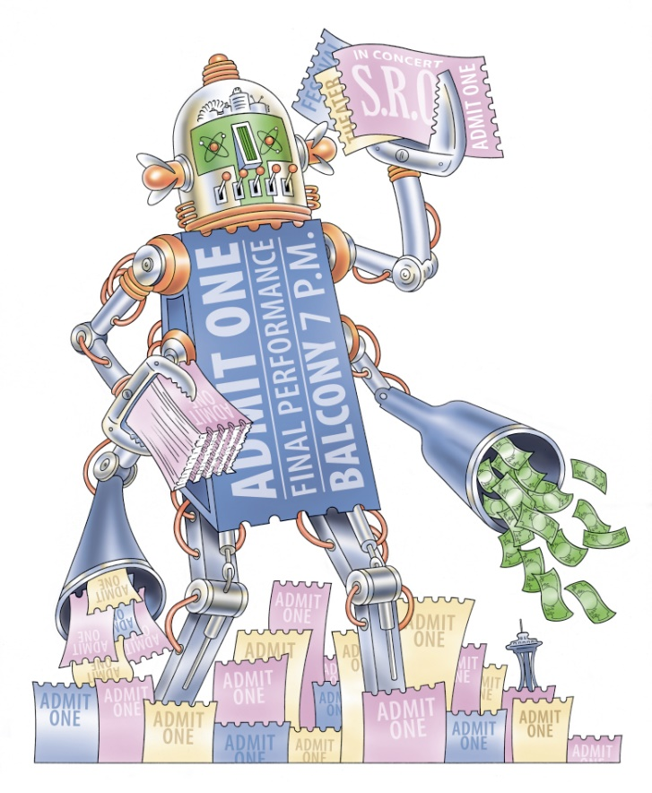
Resale Technology, Then and Now
Economics of Internet-Era Ticket Resale
No longer localized.
Massive economies of scale.
Scale in the Primary market:
  A single broker can purchase underpriced tickets across the country
  Bots to automate! Win “race to click”. (Analogy: high-frequency trading)
  Low-wage overseas workers to outwit captchas, etc.
Scale in the Secondary market:
  A single broker can resell across the country
  A single website can make markets for events across the country
Much less friction.
Also less shady.
  Ordinary customers can use eBay, StubHub, etc.
  “I paid my way through college”
Notes:
In the last 15-20 years or so, both the primary market and the secondary market for tickets have moved pretty much exclusively online
In the primary market, it’s primarily Ticketmaster, and there are of course some others
In the secondary market, its marketplaces like StubHub, SeatGeek, again Ticketmaster, and many others
Let’s think about how the internet has changed the economics of ticket resale
First, it’s no longer localized
Second, there are now massive economies of scale
In the primary market
A single broker can buy tickets across the country
Often deploying ticket-buying algorithms, called “Bots”, to automate the process and be as fast as possible. Sort of like in high-frequency trading, which is another topic I’ve researched.
Sometimes there is a human element to the ticket-buying process, like in filling out captchas or the like, but this too can be done at scale, in some reports using cheap overseas labor
In the secondary market
Again, a single broker can re-sell across the country
And a single website can make markets for events across the country
On the whole, the market has much less friction than it used to, and is also much less shady
Ordinary individuals can use eBay, StubHub, and so forth
One of the dads in my son’s pre-K, when I told him I was preparing for this talk, joked that he paid his way through college by reselling underpriced tickets

Slide 8
The Internet Broke the Old Equilibrium
It’s easy to see why an artist or sports team might wish to charge a true fan a low price.
It’s really hard to tell a story where artists or teams want to charge brokers a low price, who then charge the fans a high price on StubHub, etc.
It just makes no sense.
Notes:
Usually economists think of less friction as a good thing
But in conjunction with systematically underpriced tickets, this reduction in economic friction, and increase in economies of scale, basically BROKE THE OLD EQUILIBRIUM
As I emphasized, it’s pretty easy to tell stories for why artists or sports teams might wish to charge their fans a price that isn’t the absolute maximum the market will bear
But it’s really hard to see why an artist or sports team would want to charge a broker a low price, who then charges the fans a high price on StubHub
With such low friction, the old system broke

Slide 9
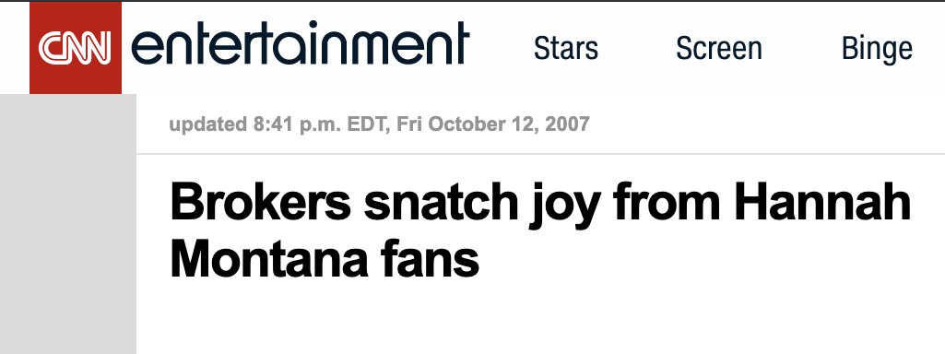
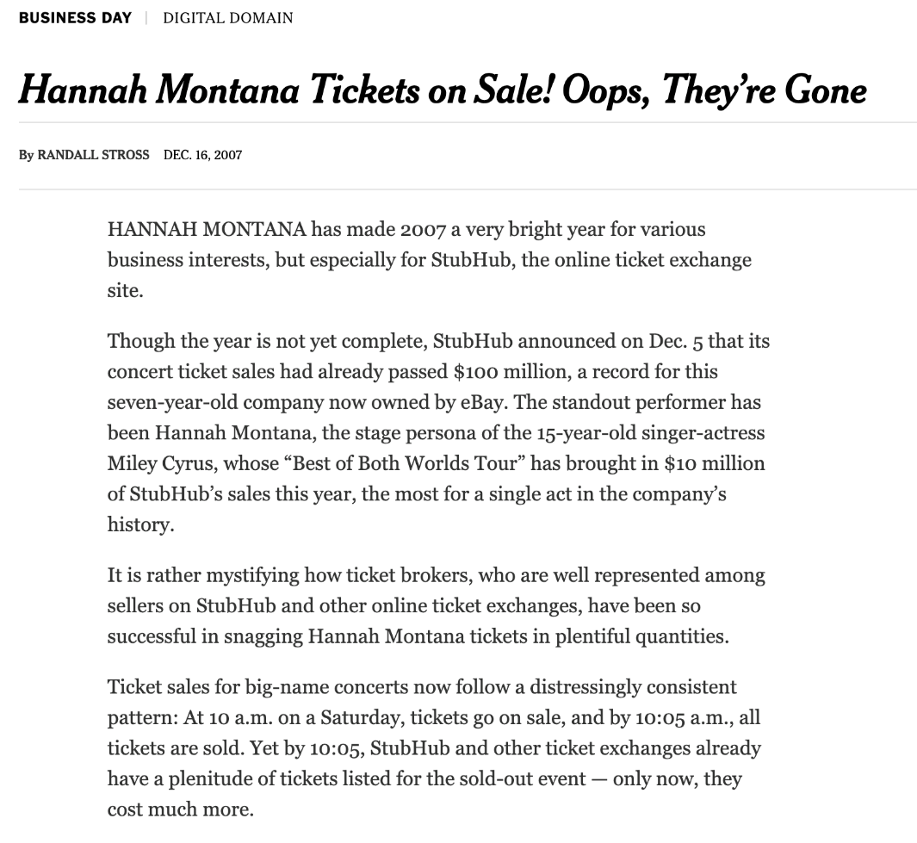
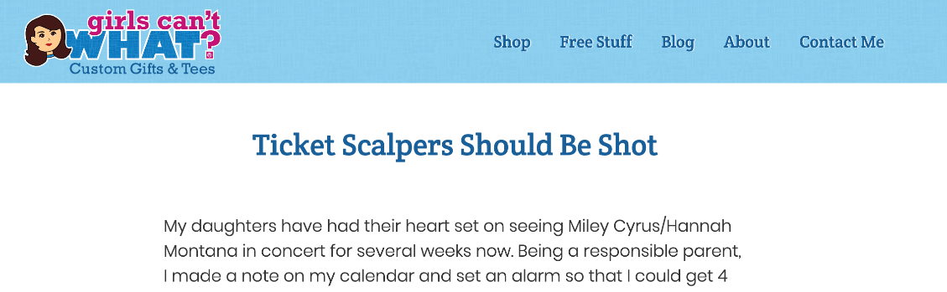
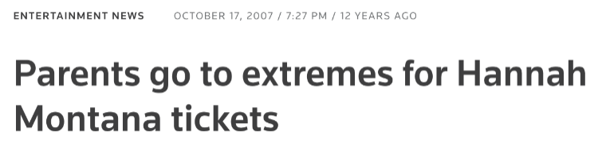
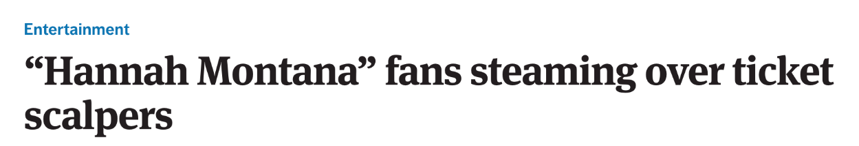
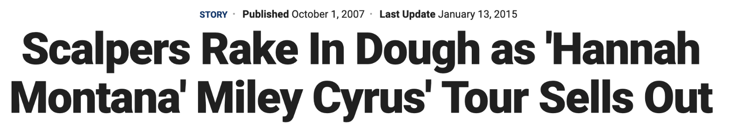
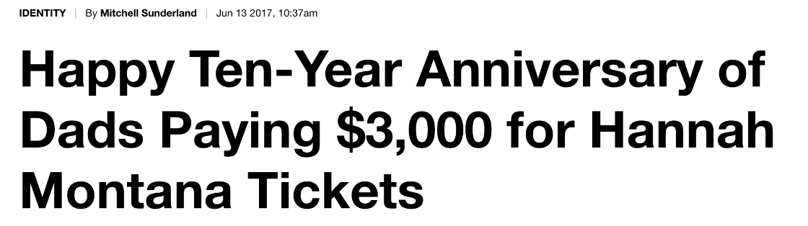
Hannah Montana
The Internet Broke the Old Equilibrium
Notes:
Here are some headlines from the 2007 Miley Cyrus tour. This is the one where she toured as both herself and her alter-ego, Hannah Montana, in what of course was called “The Best of Both Worlds Tour”
There’s a NYTimes article from the time, where it describes a “distressingly consistent pattern: At 10am on a Saturday, tickets go on sale, and by 10:05am, all tickets are sold. Yet by 10:05, StubHub and other ticket exchanges already have a plenitude of tickets listed for the sold-out event – only now they cost much more.”
Other headlines were
“Brokers snatch joy from Hannah Montana fans”
“Ticket Scalpers Should Be Hot”
“Hannah Montana fans steaming over ticket scalpers
Scalpers rake in Dough as ‘Hannah Montana’ Miley Cyrus tour sells out
And a recent one that made my dean laugh, “Happy Ten-Year Anniversary of Dads Paying $3000 for Hannah Montana tickets”

Slide 10
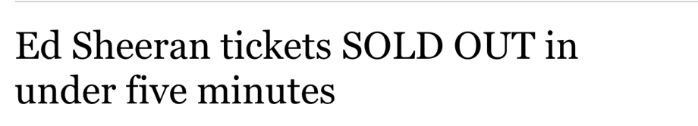
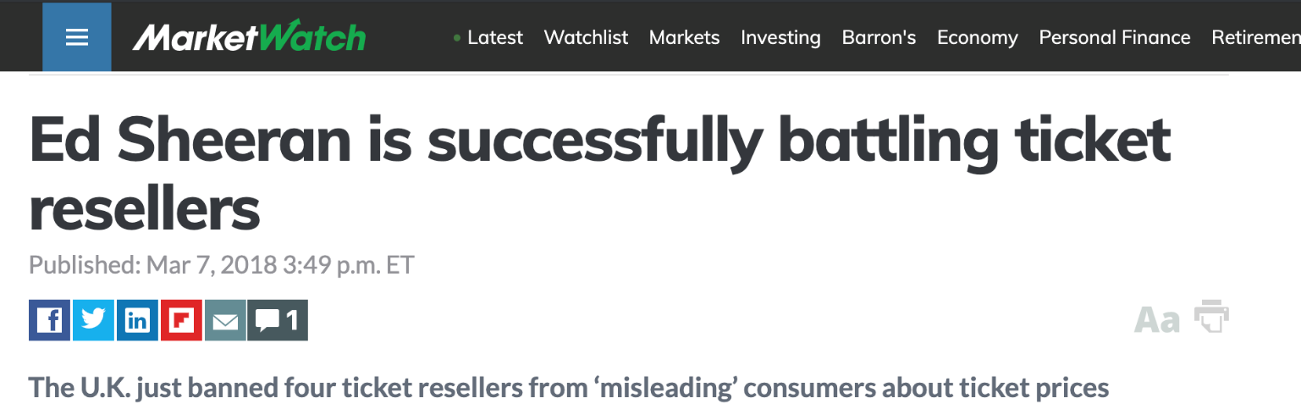
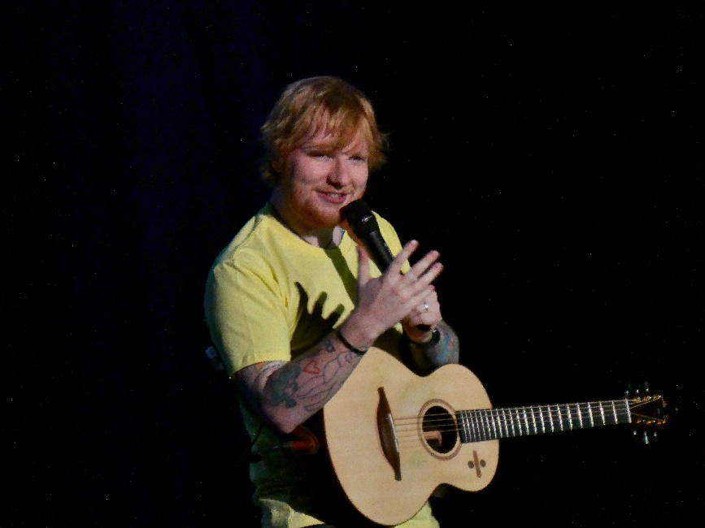
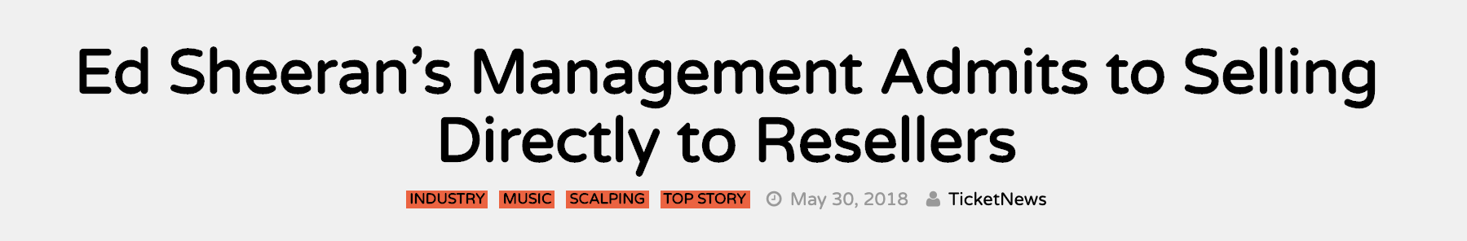
Ed Sheeran
The Internet Broke the Old Equilibrium
Photo Credit: erintheredmc. Creative Commons license
Notes:
Here’s Ed Sheeran
You’ll note one of the headlines is about his management “Selling Directly to Resellers”, which is the Corrupt Box Office thing I mentioned earlier, modern “Ice”

Slide 11
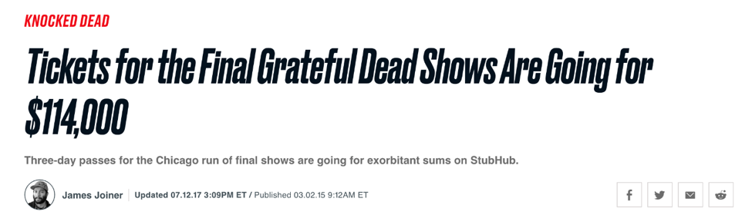
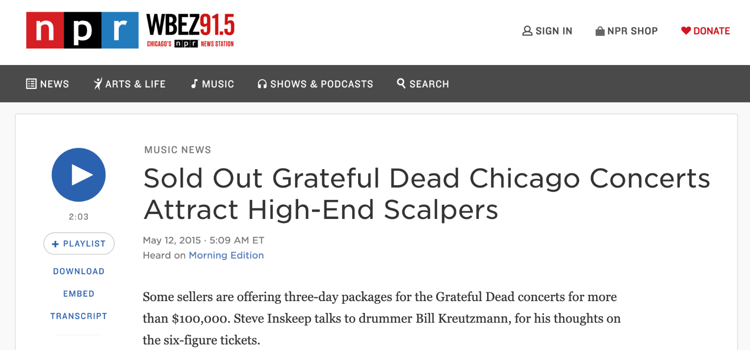
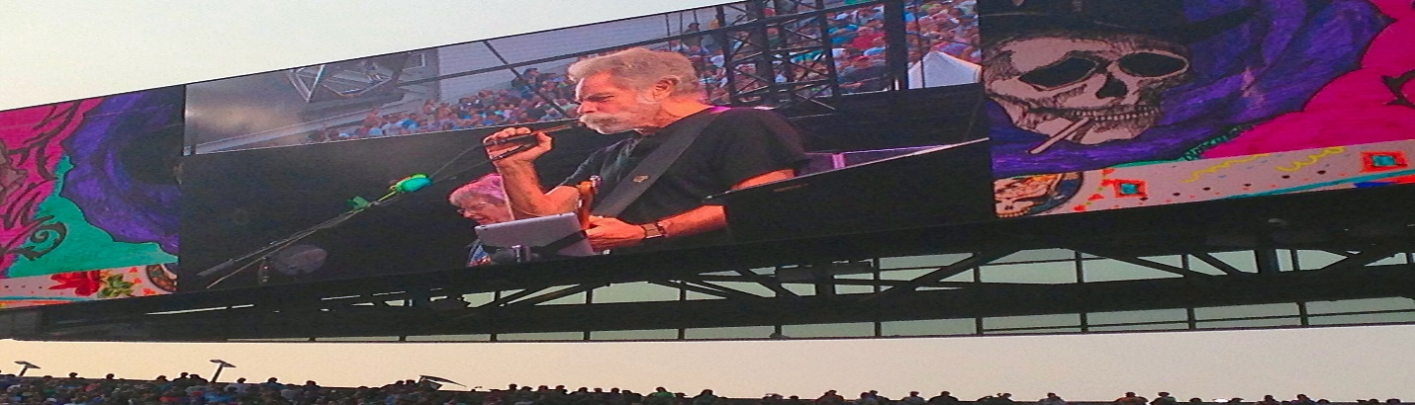
The Grateful Dead
The Internet Broke the Old Equilibrium
Photo Credit: Shelby Bell, Creative Commons License
Notes:
Here’s the Grateful Dead tour

Slide 12
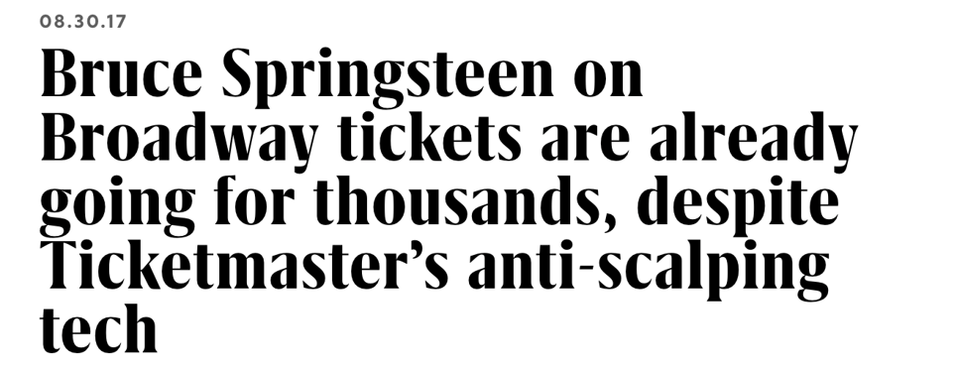
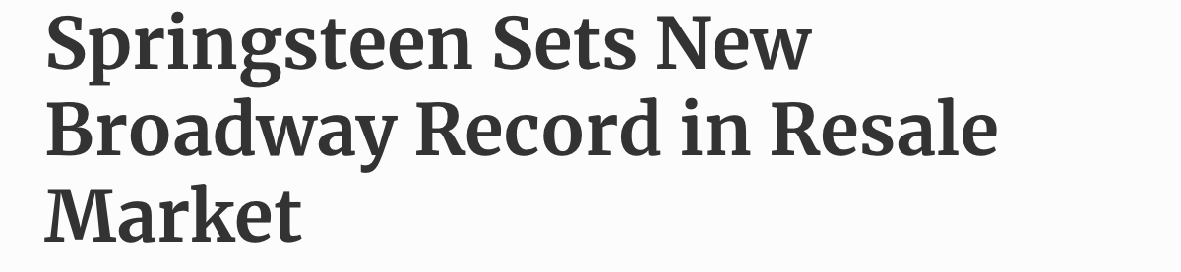
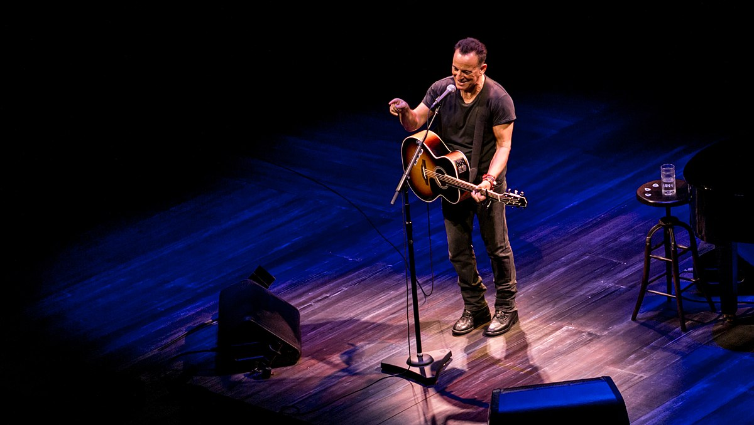
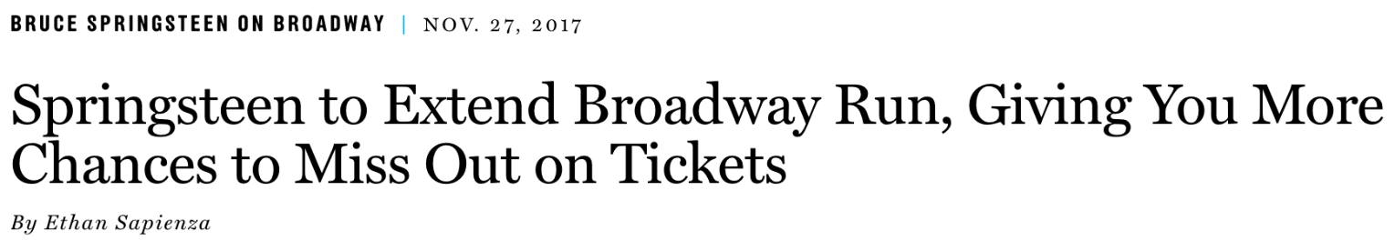
Bruce Springsteen
The Internet Broke the Old Equilibrium
Photo Credit: Raph_PH, Creative Common License
Notes:
Bruce Springsteen

Slide 13
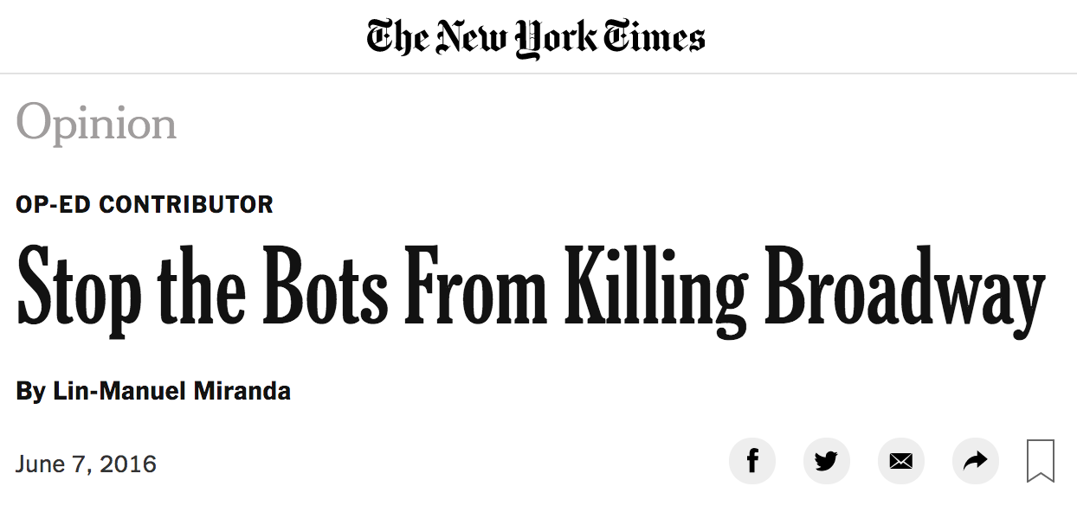
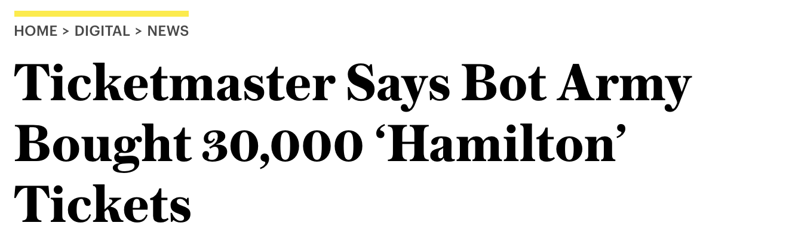
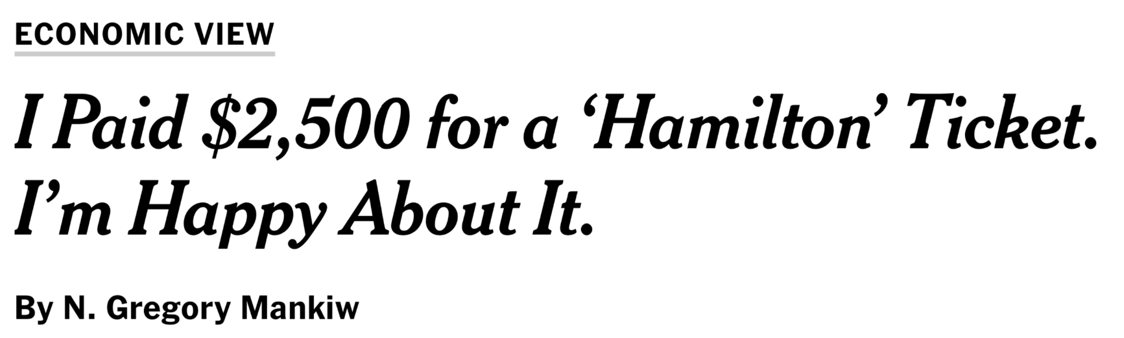
Hamilton
The Internet Broke the Old Equilibrium
Notes:
And of course Hamilton
Where the battle against ticket brokers provoked Lin-Manuel Miranda to write an Op-Ed in the New York Times
And the distinguished economist Greg Mankiw wrote a column reminding people that sometimes markets clear at high prices, and that’s ok
He bought $2500 Hamilton tickets on the secondary market, and he was delighted he had this option

Slide 14
The Internet Broke the Old Equilibrium
Notes:
When I say “the internet broke the old equilibrium”, here’s what I mean in a graph.
Before, we had supply and demand, the market clearing price, the “too low” price, and the rectangle depicted the “Money Left on the Table” by the artist or sports team.

Slide 15
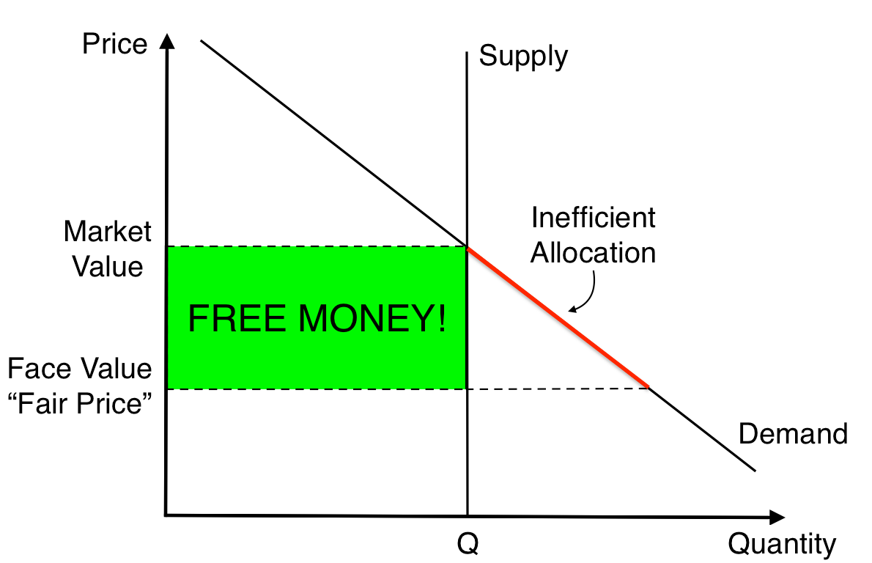
The Internet Broke the Old Equilibrium
Notes:
But with a frictionless resale market, this “Money Left on the Table” becomes what, to a ticket broker, or a college kid, etc. sees as FREE MONEY!

Slide 16
The Internet Broke the Old Equilibrium
Q: What happens when you give away FREE MONEY?
A: RENT SEEKING!
Scale of the problem …
  StubHub alone nearly $5bn of volume
  Ticketmaster another ~$2bn of volume
  Total: $15bn? (Estimates vary)
  Ticketmaster: 20% of all tickets get resold. In extreme cases, up to 90% for some events.
  Recent lawsuit against a ticket broker claimed that a single ticket broker was able to get 30-40% of all tickets to Hamilton
“The secondary market is now the market”
Notes:
And what happens when you give away free money? What economists call RENT SEEKING. Going to extreme lengths, often at extreme cost, to get your piece of the free money.
Again, high-frequency trading is an analogous example, where right now in financial markets, high-frequency trading firms are spending untold sums of money on being literally one-millionth of a second faster than their competition, to scoop up Free Money in financial markets
To give you a sense of magnitudes
StubHub alone has about $5bn of annual volume on its site, based on its 2018 10-K filing and its recent growth rate
Ticketmaster, based on its 2015 reported figure of $1.2bn, and reports since of growth rates of between 16%-24%, has about $2bn of volume, give or take
The market has a whole has been estimated to be on the order of $15bn
Ticketmaster said publicly in 2011 that 20% of all tickets purchased in the primary market are resold, and that figure has surely gone up since 2011.
They told me that in extreme cases, bots and other speculators could amass as many as 90% of the tickets for a particular event
A lawsuit related to Hamilton claimed that a single broker got 30-40% of all Hamilton tickets, which is kind of crazy.
So basically, the FREE MONEY has been scooped up by brokers and the secondary market, and we’re now in a situation where “The secondary market is now the market”.

Slide 17
Who Gets the Rents From Resale?
Example
  $100 primary-market price (inclusive of fees)
  $200 secondary-market resale value (inclusive of fees)
  $200 - $100 = $100 is “economic rent”. The “prize” in the rent-seeking competition.
  Secondary market venue fee:
    15% of resale price to buyer
    15% of resale price to seller
    Resale price = $174 (because $174 (1 + 0.15) = $200)
    Total fees = $52
  Broker profits
    Broker gets the rest of the economic rent: $100 - $52 = $48
    Equivalently, gets $174 * (1- 0.15) = $148 net of fees, paid $100, nets $48
  Punchline: at current fees, secondary-market platform gets a large chunk of the underpricing rents. For tickets with 100% markup, split is about 50/50.
Notes:
Before I get into how to fix the problem, I want to go over some simple math about how the pie gets divvied up. That is, WHO GETS THE RENTS from resale
Suppose there is a ticket where the price in the primary market is $100, inclusive of all fees. That is, the buyer’s out of pocket expense is $100, all-in
Suppose that same ticket’s true market value, in the secondary market, is $200, inclusive of all fees. That is, the market-clearing price for the ticket, inclusive of all fees, is $200
The difference between these two prices, $200 minus $100 which is $100, is the “economic rent”, or the “prize” in the rent-seeking competition to buy mispriced tickets
This is a fairly typical level of mispricing – in my own study, and in two other well-known studies [Sweeting in the JPE, and Leslie and Sorensen in REStud], the average observed secondary market resale price was about twice the primary market price.
Let’s do some quick math on fees
Suppose the secondary market’s fee is
15% of the resale price to the buyer, and 15% of the resale price to the seller. As you’ll see on the next slide, this is actually a bit too low.
The secondary market doesn’t collect fees on the $200, but on the price as displayed on the site, which is pre the Buyers’ fees. This would be $174 in this example, because $174 plus 15% equals $200
So the secondary market site would collect 15% of $174 from the buyer, and another 15% of $174 from the seller, for total fees of $52
What are the broker’s profits?
Well, the broker gets the rest of the economic rent. There was $100 of economic rent, of which the secondary market platform got $52, leaving the broker with $48
Another way to see this is to take the $174 price listed on the site, subtract the 15% fee paid by the seller, that gets you to $148 for a ticket they bought for $100, so $48 in profit.
PUNCHLINE: at current fees, the rents from underpricing get split between the broker and the secondary-market platform. In this example, the split is about 50/50.

Slide 18
Who Gets the Rents From Resale?
Platform | Buyer Fee | Seller fee | Total Fee as % of All-In |  | % of Rent Captured by Platform if Ratio of Market Price to Face Value equals: (^)
 |  |  | Price to Buyer (*) | Take-home to Seller (**) | 1.5x | 2x | 5x
StubHub | 22% | 15% | 30.3% | 43.5% | 91.0% | 60.7% | 37.9%
Ticketmaster | 17% | 14% | 26.5% | 36.0% | 79.5% | 53.0% | 33.1%
SeatGeek | 30% | 10% | 30.8% | 44.4% | 92.3% | 61.5% | 38.5%
VividSeats | 28% | 10% | 29.7% | 42.2% | 89.1% | 59.4% | 37.1%
TickPick | 0% | 10% | 10.0% | 11.1% | 30.0% | 20.0% | 12.5%
Note: Fees as observed by the author on June 6th, 2019 for tickets for the Rolling Stones, Chicago, June 21st, 2019.
(*) computed as (Buyer Fee + Seller Fee) / (1 + Buyer Fee)
(**) computed as (Buyer Fee + Seller Fee) / (1 – Seller Fee)
(^) see previous slide for example of calculation
Notes:
Here’s a table with lots of different versions of that same math.
In the first few columns you see the actual Buyer and Seller Fees, for 5 secondary market sites. These are the fees observed by me and my research assistant in the market for Rolling Stones tickets in Chicago, fees can vary somewhat across events.
For example, StubHub’s fee to the buyer was 22%, and to the seller was 15%
In the next two columns, some algebra turns these two fees into a single “total fee”. You can think of this total fee either as a % of the all-in price paid by the buyer, the $200 in the previous example, or as a % of the all-in price received by the seller, the $148 in the previous example. You can also just sum the two fees, so 22%+15%=37% to get the fee as a % of the listed price on the site.
The last three columns then ask what % of the “Economic Rent”, or “Prize” is captured by the secondary market, for different degrees of mispricing. The “2x” column corresponds to the example on the previous slide, where the price in the secondary market is 2 times the price in the primary market. You’ll see the secondary market’s capture of the rents is about 50-60% for StubHub, TicketMaster, SeatGeek, and VividSeats, and about 20% for TickPick, which doesn’t charge buyer fees.
In the 5x column, you can see that for events where the primary-market is really dramatically underpriced, so there is a 5x difference, the secondary market still captures about 35% of the rent
In the 1.5x column, so cases where there is a relatively modest difference between the primary market price and the secondary market value, the secondary market’s share of the rents is much higher
In case it’s not obvious, what drives this math is that the secondary markets all charge fees based on the SALE PRICE of the ticket, not the RESALE PROFIT of the ticket. So 30-40% of the sale price, on a ticket you can only mark up by about 50%, is a lot of the economic pie.

Slide 19
Economic Gravity
THREE CHOICES
Set a market-clearing price in the primary market.
Set a below-market price in the primary market. Much of the “real” allocation will happen in the secondary market.
Set a below-market price in the primary market + ban resale.
Key point: setting a below-market price, and hoping/praying that the tickets go to fans and never get resold, is economics fantasy land.
  The way to get tickets to fans and not have them get resold, is to either set a market-clearing price in the first place, or to prohibit reselling them.
Notes:
I now want to turn to how to fix this market
And to do so, the 3 basic choices that artists and teams have in this market, based on economic logic, or what I’ll call “Economic Gravity”
Choice 1, the most standard economics choice, is to SET A MARKET-CLEARING PRICE in the primary market.
Choice 2, is to set a below-market price in the primary market, but then have most of the “real” allocation happen in the secondary market. Brokers will scoop up a lot of the under-priced tickets in the primary market for resale on the secondary market.
Choice 3 is to set a below-market price in the primary market, and BAN RESALE.
The key point I want to emphasize is that what’s NOT A CHOICE is to set a below-market price, and then just hope and pray that fans will get the mispriced tickets, and there won’t be a fervent secondary market.
I agree that primary-markets can do a better job of detecting and diverting Bots, and like the overall idea of Verified Fan that Ticketmaster has been pursuing, but that’s just a never-ending cat-and-mouse game between the primary market and the brokers.
The economically reliable way to get tickets to fans and not have them get resold, is to either set a market-clearing price in the first place, or to prohibit resale.

Slide 20
Choice 1: Market-Clearing Price
Stakeholder | Effects
Artist / Team | Pro: more revenue But: bad PR? Risk of empty seats (TSwift)
Secondary Markets | Con: less volume … took away the “free money” Still a role for secondary market, just reduced
Brokers | Con: took away the “free money”! Nuance: also engage in less rent-seeking activity
Fans | High prices Arguably similar allocation to status quo Fans who would have been able to purchase at below-market price are worse off
Methods
  Auctions
  Dynamic pricing
  Use past data
Notes:
Let’s now go through each of these 3 choices, starting with Market-Clearing Prices
There are a few methods for setting market-clearing prices.
A rare one, but fond to economists, is Auctions. I’ll talk about that more on the next slide.
The most common one is to use what’s called Dynamic Pricing, in conjunction with Data, to set market-clearing prices.
Basically, use good data, including resale-market values, to understand what prices clear the market.
Then, if you’re too low, dynamically raise the price, and if you’re too high dynamically lower the price.
What are the effects of market-clearing prices on the various stakeholders?
ARTIST/TEAM
Well, they get a market-clearing price, so more money
The possible downside is bad PR, if the price the market will bear is seen as too high, or if they overshoot. The Taylor Swift tour last year seemed to have a bit of that
SECONDARY MARKET
Secondary markets will have less volume, because setting a market-clearing price in the primary market takes away a lot of the FREE MONEY
There will still be an important role for the secondary market, just smaller than it is at the moment
BROKERS
Brokers are badly hurt, because you took away the “free money”
One economic nuance is that brokers spend a lot of time and money trying to win underpriced tickets. Economically, the “marginal” broker shouldn’t be making a huge profit net of his time and money costs.
FANS
Last, fans, pay market-clearing prices
Many will grumble that the price is too high
Fans who would have been the lucky ones in the old regime, able to buy underpriced tickets, are worse off

Slide 21
Evidence on Auctions
Average Prices
Auction: $274
Resale: $280
Average Prices
Face: $145
Resale: $280
Source: Aditya Bhave and Eric Budish, “Primary-Market Auctions for Event Tickets: Eliminating the Rents of ‘Bob the Broker’”
Notes:
No surprise to an economist, market-clearing prices work, in the sense of clearing the market.
Here is evidence from my research paper on Ticketmaster’s use of auctions for premium seats, which they used from about the mid-2000s through about 2011.
On the left-hand side, you see on the horizontal axis the price for seats in the primary market, and on the vertical axis the price in the secondary market. Each dot is a “Concert-Section-Row”
As you can see, the dots line up against the red line, which means the primary-market auction “got the right price” in terms of what the secondary market would bear, at least on average. The average auction price was about $274, the average resale value about $280
On the right-hand side is the same seats, but using the face values instead of the auction prices. You can see that the face values are systematically too low, with a few extreme cases. On average, the markup between the face value and the resale value was about 100%

Slide 22
Choice 2: Underprice, Much of the Allocation in the Secondary Market
Stakeholder | Effects
Artist / Team | Less money than market-clearing price Less heat from fans. “Tried” to set a fair price Some artists/teams seem to divert tickets to secondary market, to get market price
Secondary Markets | Winner: get a big share of the free money
Brokers | Winner: get a big share of the free money Nuance: “marginal” broker should break even, free entry (Hsieh and Moretti, 2003)
Fans | HATE THE STATUS QUO. Hence 6724 comments to FTC.
Notes:
Now let’s talk about Choice 2, which is to underprice, and let much of the action take place in the secondary market.
This is basically the status quo
Artists and teams
Get less revenue, this is the “underpricing”
But get at least some of the benefits of appearing to set a low price
Some artists try to “have their cake and eat it too”, diverting tickets to the secondary market through their promoters. This too is a modern version of the Corrupt Box Office practice I mentioned earlier and shouldn’t be allowed
Secondary markets and Brokers both clean up
Again with the nuance that brokers have to expend a lot of money and time seeking underpriced tickets, so the “marginal” one in some economic sense breaks even
And secondary markets of course spend a lot of money on internet advertising and otherwise to try to get the market to happen on their secondary market site rather than someone else’s
Fans …
Well FANS HATE THE STATUS QUO.
There were 6724 comments submitted to the FTC.

Slide 23
Choice 3: Low Prices, Ban Resale
Implementation Details
IDs, credit cards, or phones to tie ticket to buyer (analogy: plane tickets)
Some scope for refund if plans change, with penalty fees (analogy: plane tickets)
Speculator who buys N tickets could resell N-1 of them, “walk them in”, but this doesn’t scale. More like Dickens-era resale than Bots-era resale
Reference: Pascal Courty, “Ticket Resale, Bots, and the Fair Price Ticketing Curse”
Stakeholder | Effects
Artist / Team | Can set the price they want, including below-market
Secondary Markets | HATE THIS.
Brokers | HATE THIS.
Fans | Pay “fair price”. The “free money” goes directly to them. Some allocative inefficiency. Even if I really want to go, may not be able to. (Greg Mankiw $2500 for Hamilton tickets).
Notes:
Last but not least, Choice 3.
Low prices, but with a ban on resale
First, let’s talk through the implementation details for this approach
It relies on “names on tickets” with some sort of customer identifier, like an ID, a credit card, or their phone. By analogy, like how plane tickets work
Ideally, there would be some scope for refund for customers whose plans change, and can cancel far enough in advance that someone else can purchase and then utilize the ticket
Again, analogy is an airline fee
Since customers often attend events in groups, and groups can be fluid, there is intrinsically some scope for a form of resale – broker buys the tickets, then “walks the fans in the door”
However this doesn’t scale that much, its more like Dickens-era resale, or Spitzer-era resale, than Bots-era resale
A good reference on this idea is a recent paper of Pascal Courty
What are the effects of this method on stakeholders
Artists and Teams
Can set whatever price they like, including a below-market price
Secondary markets and brokers
HATE this idea
They probably hate it as much as fans hate the status quo
Fans
Pay a “fair price”
Some still won’t get to buy – there is excess demand at that price
And there will be some allocative inefficiency
Some fans who BADLY want to go and would have paid a lot won’t get tickets

Slide 24
Politics of Choice 3
Concentrated Interests oppose it
  Secondary market players
  Brokers
  Arguably Ticketmaster, which has taken a “join the party” approach to the secondary market, now at ~$2bn volume
Dispersed Interests benefit
  Fans
Artists/Teams may have a loud-enough voice to effect change
Notes:
The politics of Resale Bans are, sadly, predictable
Economically, they benefit a dispersed group, fans
But harm a concentrated group, the secondary market players
This includes the secondary market platforms
Brokers
And arguably Ticketmaster, which has taken what you might call a “join the party” approach to the secondary market, now at around $2bn volume which at their current fees is about $500 million of revenue
A group called the “Fan Freedom Project” got formed for the purpose of advocating against resale bans.
The name is almost comically Orwellian
I want to read you an excerpt from their non-profit filing,
The mission is to quote “Preserve, Educate and Inform Consumers of their FUNDAMENTAL RIGHTS “ … “including rights to a free and open secondary ticketing marketplace”
I love the cynicism, “Fundamental Rights”, right up there with life, liberty and the pursuit of happiness, to speculate on concert tickets
I’ll let you guess who funded it

Slide 25
Policy Proposal I
Artists and Teams should have the CHOICE to restrict resale for some or all of their tickets
Notes:
My main policy proposal is that artists and teams should have the CHOICE to restrict resale for some of all of their tickets
That is, if they want to set a meaningful below-market price, that should be a choice that they have

Slide 26
Policy Proposal I, cont.
“FREE MONEY” -> massive rent-seeking, broken market.
Only 2 real alternatives to the status quo
  1) Set a market-clearing price (Taylor Swift, Rolling Stones)
  2) Set below-market prices, restrict resale
I propose that artists/teams be free to choose their preferred mix of (1) and (2)
  I suspect many will choose some of both
I understand both (1) and (2) are bad for secondary-market players
  You may hear some complaining …
  Chicago economists have a thick skin.
Notes:
Essentially there are only 2 real alternatives to the status quo
1) set a market-clearing price
2) set below-market prices, but restrict resale
Again, I like the idea of trying to deter bots and brokers in other ways, but that’s ultimately a cat-and-mouse game, which the ticketing industry has been losing, in some cases perhaps purposefully, for over 100 years.
The only truly reliable ways to allocate tickets to fans and not brokers are to set market-clearing prices in the first place, or to restrict resale. That’s just economic reality.
What I am proposing is that artists and teams be FREE TO CHOOSE their preferred mix of these 2 alternatives
I suspect many will choose just to set market-clearing prices, which again is standard economics, or to do a mix of (1) and (2), perhaps allocating some premium seats at high prices, but allocating the “get in the door” seats at low prices with resale restrictions
That’s all fine. My proposal is NOT to mandate resale bans, but to MEANINGFULLY ALLOW them.
I understand that resale bans are bad for secondary-market players and brokers. You may hear complaining, that’s fine.

Slide 27
Policy Proposal II
Fee transparency
  Fees are both OPAQUE and HIGH
  In both the PRIMARY and SECONDARY markets
Proposal: adopt the DOT model
  You have to show the all-in price, if the fee is mandatory (i.e., can’t buy the ticket without paying the fee)
Note: firms will not “unilaterally disarm”
  StubHub experiment shows that transparent fees, in the context of a market that is otherwise often non-transparent, is very costly
  (Blake, Moshary, Sweeney and Tadelis, “Price Salience and Product Choice”)
Notes:
My second policy proposal is more “conventional economics” if you will, which is just to have transparency for fees in this market
Fees are both OPAQUE and HIGH
In BOTH the primary market and the secondary market
I propose that the tickets industry adopt the Department of Transportation model for the Airline industry – which is that if a fee is a “mandatory” part of the ticket, you have to include it in the displayed price
Airlines can’t charge $300 for the ticket, and then surprise you that it’s another $300 for the seatbelt and another $100 bucks to use the bathroom.
I want to underscore that the industry likely won’t unilaterally disarm against opaque, high fees. Scientific evidence that came out of an experiment at StubHub found that if one marketplace makes fees transparent, while others keep them non-transparent, the transparent one did worse.
Commissioner Slaughter called the situation a prisoner’s dilemma – that’s exactly right

Slide 28
Concluding Thoughts
The ticket market has been broken for a long time
  The structural economic issue is artists/teams sometimes want to “underprice” their tickets relative to what the market will bear (fairness, PR, long-run economic interests, etc.)
  This creates an incentive for rent-seeking behavior
The internet has badly exacerbated the problem
  Rent-seeking has gone haywire
  For many events, the secondary market is now the market
Two proposals that would do a lot of good to fix the market:
Allow artists and teams the choice to restrict resale for some or all of their tickets.
Fee Transparency. In both the primary and secondary market.
Notes:
Let me now bring this talk to a close, with one slide to summarize and one slide to put these ideas in a slightly broader economic context
The ticket market has been broken for a LOOOONG Time
The structural economic reason why is that artists / teams / etc sometimes want to “underprice” their tickets relative to the maximum the market will bear
This could be out of concerns about “fairness”, real or perceived
A concern that too high a price today will harm demand tomorrow
A desire to ensure that seats can make it to true fans
Etc.
Wherever it comes from, it’s a fact of this market
This underpricing in turn creates an incentive for rent-seeking behavior
Hence, $30 in gold for a good spot in line, over a 150 years ago, for a novelist!
The INTERNET HAS BADLY EXACERBATED this basic structural problem
The internet reduces friction, which is usually a good thing …
but in this case the friction was what allowed the market to not get fully taken over by speculators
I have outlined two proposals that would do a lot of good for this market, in the internet era
1st, allow artists and teams THE CHOICE to restrict resale for some or all of their tickets
Not a mandate to ban resale
Indeed, I would imagine that most events would continue to price roughly the way they do, and for efforts to set market-clearing prices to get increasingly sophisticated and more accurate
But, for special events where demand is through the roof, and the artist/team genuinely doesn’t want to price to capture full revenue from that demand, that should be their CHOICE
(If they want to price through the roof, that should be their right too!)
(And if they want to price low and let the rents go to brokers/secondary market players, I guess that should be their right too. But we shouldn’t FORCE them into this third bucket.)
The 2nd proposal is to put some transparency into this market, specifically around fees, in both the primary and secondary markets.
The idea is not special to tickets market
Just good economics
The only sense in which the proposal is special to the tickets market is that tickets themselves are special. Consumers often genuinely badly want to go to a particular event. Events are “one of a kind” and create cherished memories, like the moment the mets clinched the pennant.
But this specialness then makes consumers vulnerable, and HIGH and especially OPAQUE fees exploit this vulnerability.

Slide 29
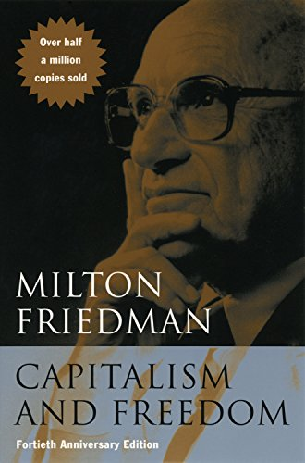
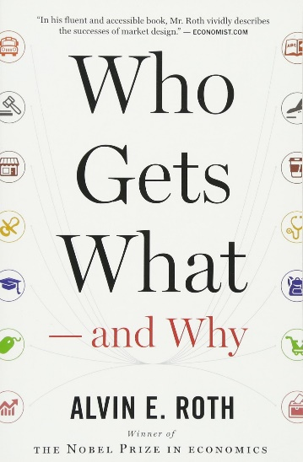
Concluding Thoughts
I want to close by connecting these two simple policy ideas to ideas that I’ve learned from two influential figures in the history of economic thought:
Milton Friedman
  “Free to choose”
  “Rules of the game” as the role of government
Alvin Roth
  Market Design
  Matching: some markets don’t clear through price alone
I think the tickets market may be one where we’ve learned, from 100+ years of history, that price alone may not be the only determinant of “who gets what”
Whether artists/teams determine the allocation based on who pays the most, who’s willing to wait in line, likes on Instagram, etc., it should be their choice.
And whether in the cheap seats or front row, fans deserve a transparent market
Notes:
I want to close by connecting the ideas in this talk to two influential figures in economics, from whom I’ve learned an enormous amount
First is Milton Friedman
I’ve used the phrase “free to choose” a few times in this talk, which is a Friedman phrase. Artists and teams should be free to choose the nature of the contract they sell, within reason. Ticket resale is NOT A FUNDAMENTAL RIGHT.
Another important Friedman theme is that markets need rules to function well – the notion of Government as the rule-setter and umpire.
Let me read a famous quote of Friedman: “The role of government just considered is to do something that the market cannot do for itself, namely, to determine, arbitrate and enforce the rules of the game”
You may be surprised to hear a U of C economist before you encouraging the FTC to regulate a market, but that’s a misunderstanding of Chicago economics. Markets need rules to function well, full stop.
Second is Alvin Roth, my PhD adviser and winner of the 2012 Nobel Prize
Roth was recognized for his work on the design of what are known as matching markets.
He points out that while many markets clear through prices alone, many markets don’t – price isn’t the only determinant of “Who Gets What”
Examples include getting into a college, choosing a spouse, or getting a job
You can’t just choose which job you want, the employer has to choose you back
You can’t just choose which college you want to go, the college has to choose you back. With the possible exception if you bribe the lacrosse coach.
In the tickets market, we’ve learned, from 100+ years of history, that sellers, and buyers, don’t want a market in which prices alone are always and everywhere the only determinant of who gets what.
Whether artists and teams determine the allocation based on who they think is the “true-est” fan, or who pays the most, or who waits the longest in line, or whatever, it should be their choice.
And whether in the cheap seats or courtside, fans deserve a transparent market

